Slide 1
HW2: Some instructions
Deep learning image salient object detection model
(For reference only)

Slide 2
Outline
Introduction of deep-learning
The purpose of deep-learning model
What is the salient object detection?
The training data set
Take deep leaning based salient object detection as example
A peek in the dataset
Homework instructions
(1) Testing data preparation (測試SuperCNN用的資料準備)
(2) LabelMe tutorial (LabelMe教學)
(Part II, in the begining) Retrieve the model code (取得程式碼)
(3-3-1, 4-1-2) Data preprocessing: superpixel segmenatation (訓練/測試SuperCNN用的資料所需的超像素前處理)
(3-3-2, 4-1-3) SuperCNN: Model training and testing (訓練/測試SuperCNN)

Slide 3
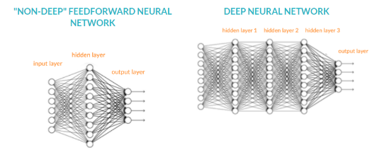
The purpose of deep-learning model
What is the deep learning?
A solution to allow computers to learn from experience and understand the world in terms of a hierarchy of concepts.
The hierarchy of concepts allows the computer to learn complicated concepts by building them out of simpler ones.
We draw a graph showing how these concepts are built on top of each other.
If the graph is deep and construct with many layers, the kind of approach is called AI deep learning.
Notes:
深度學習旨在 讓電腦能透過一個概念的層次結構及無數的”經驗”來學得一個”知識”
結構通常以演算法建一個 圖(graph) 來描述 這些概念之間的連結關係
如果這個 圖(graph) 很深(deep)，則稱其為deep learning
\\(From deep learning of Ina Good Well.)
This book is about a solution to these more intuitive problems.
This solution is to allow computers to learn from experience and understand the world in terms of a hierarchy of concepts, with each concept defined in terms of its relation to simpler concepts.
By gathering knowledge from experience, this approach avoids the need for human operators to formally specify all of the knowledge that the computer needs.
The hierarchy of concepts allows the computer to learn complicated concepts by building them out of simpler ones. If we draw a graph showing how these concepts are built on top of each other, the graph is deep, with many layers.
For this reason, we call this approach to AI deep learning.

Slide 4

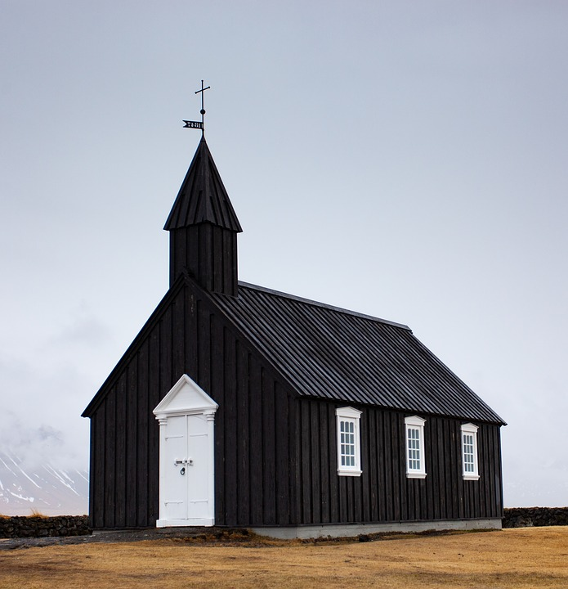
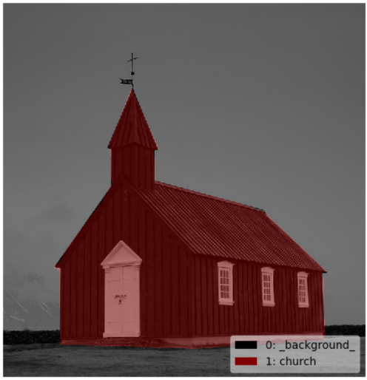
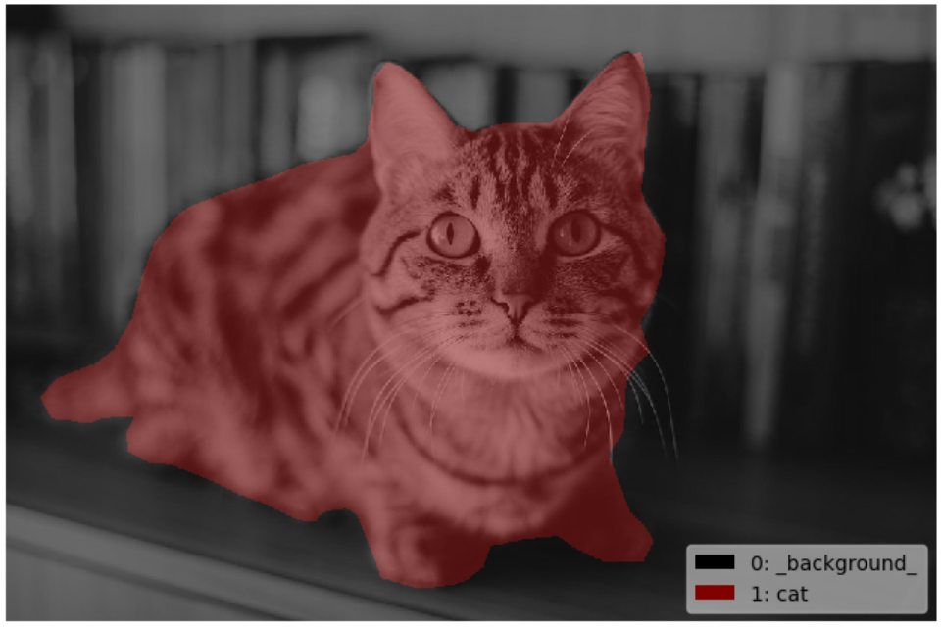
What is the salient object detection?
In the scene of a image, there are some object will obtain most of the visual attention of the viewer. The salient objects are specific to these objects.
The objective of salient object detection is to found out where are these objects located in the scene of image by methods.
Object which attract my attention.
Notes:
在一張影像當中，有些特定物體會吸引觀賞者多數的視覺注意力。
salient object detection的目標就在於利用某些方法找出這些物件的存在。
(在這個作業裡，方法將會被特定為 用 deep learning 的架構來處理；實際上完成salient object detection並不限制於deep learning 的方法)

Slide 5
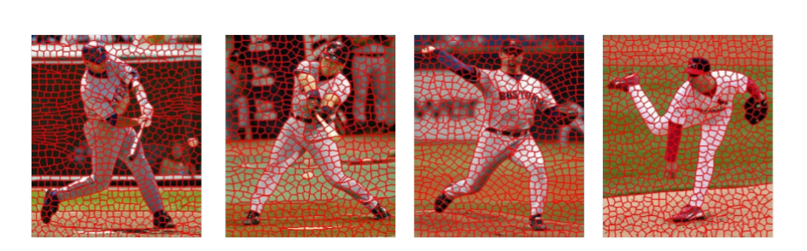
What is superpixel segmentation?
Superpixel is a group of connected pixels with similar colors or gray levels.
Superpixel segmentation is dividing an image into hundreds of non-overlapping superpixels.
There are two major advantages for using superpixels.
Compute features on more meaningful regions.
Reduce the input entities for the subsequent algorithms.

Slide 6
Let the computer “learn”
To train the deep learning model to learn for the specific purpose, we need a massive of data providing as the “experience” for the computer to “learn the knowledge”.
<Deep learning model>
Refine the generated answer from the experience.
Provided data as “experience”
(Massive data)
Obtain the correct “knowledge”
(Response the answer)
Notes:
要讓電腦能夠學會”知識”，要提供其足夠的”經驗”來學習
根據想要的知識需要提供正確的資料作為學習經驗來源，並提供適當的解答來學得知識
以影像處理的深度學習而言，大量的影像資料為重要的資料來源
MSCOCO: a large-scale object detection, segmentation, and captioning dataset.
ImageNet: an image database organized according to the WordNet hierarchy (currently only the nouns), in which each node of the hierarchy is depicted by hundreds and thousands of images
MSRA10K: pixel accurate salient object labeling for 10000 images from MSRA dataset. The contents include the images and the binary masks

Slide 7
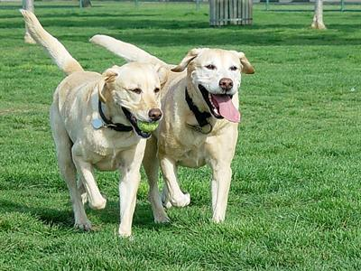

The preparation for deep learning: Image salient object detection
Take the deep learning based image salient object detection as example, the needed experience are “the original images” and “the answer of the location of salient object”.
A lot of data sets are open-accessed for deep learning model, here we list some of the famous image processing related datasets
MS COCO (Common object in context).
MSRA10K.
ECSSD dataset.
ImageNet.
(Experience for learning)
result
“the original images”
model
Massive data
“the answer of
the location of salient object”.
Notes:
以目標:
找到畫面中的視覺顯著物體微粒
在
深度學習裡的架構中
要提供:
大量圖像以及標示有視覺顯著物體的答案(可能是影像，也可能是座標)
以這次的作業目標: 視覺顯著物體偵測為例
有上述4種database提供大量影像資料作為訓練基礎

Slide 8
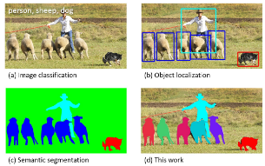
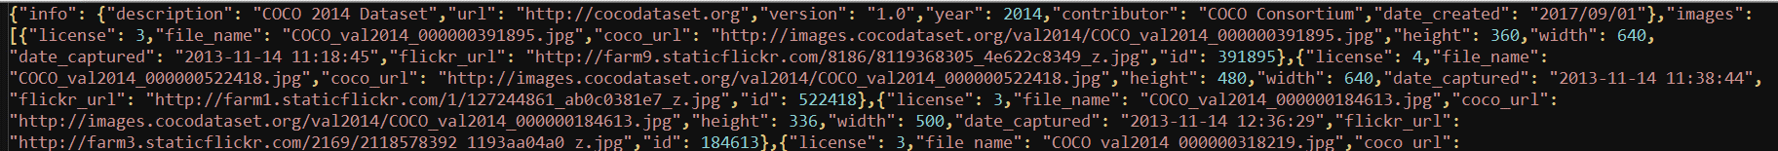
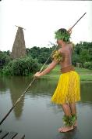

The content of famous dataset
MS COCO :
The images: the training images, the validation images & the testing images
The image annotations & information in json
MSRA10K :
Images contain salient object.
The binary mask of image to indicate the existence of object.
In this time of assignment,
we use images and binary masks this type of data.
Notes:
不同的資料集中，不同的資料格式 (稍微看一下，第二種是我們要使用的資料型態)

Slide 9
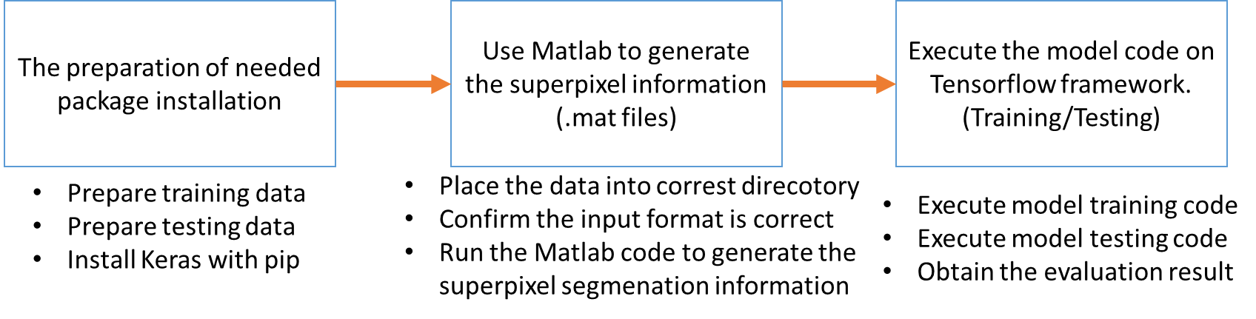
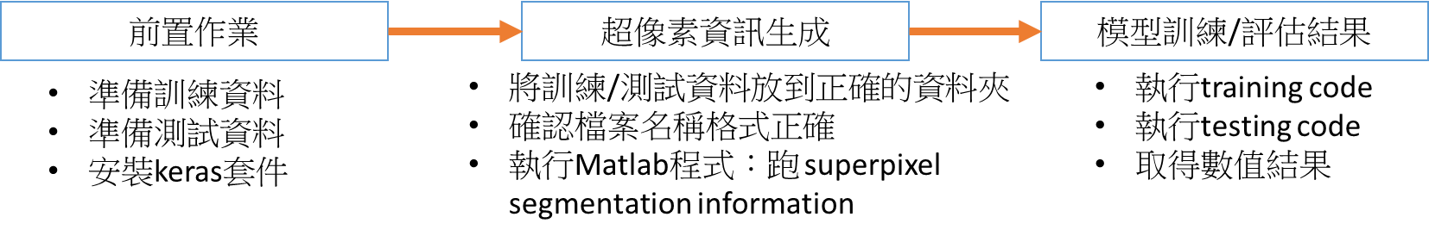
Homework instructions
For the students that may not have CS background, the following slides are some practical instructions to do the homework.

Slide 10
Outlines for homework instruction
(1) Testing data preparation (測試SuperCNN用的資料準備)
(2) LabelMe tutorial (LabelMe教學)
(Part II, in the begining) Retrieve the model code (取得程式碼)
(3-3-1, 4-2-1) Data preprocessing: superpixel segmenatation (訓練/測試SuperCNN用的資料所需的超像素前處理)
(3-3-2, 4-2-2) SuperCNN: Model training and testing (訓練/測試SuperCNN)

Slide 11

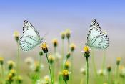
Testing data preparing
All the color image should be saved in JPG format,
resolution 960*640
3 types of images you need to prepare:
Indoor (室內照片) natural scene: An indoor scene picture token by you with salient object in it.
Outdoor (室外照片) natural scene: An outdoor scene picture token by you with salient object in it.
Artificial objects (人工創造的物體) in the images: A hand-drawing or computer drawing object in the canvas
Notes:
準備訓練模型用的資料
訓練: 用既有資料集的資料處理
測試: 用自己準備的3張影像
1. 用labelme產生視覺顯著物體位置標記
2. 用產生的資料進行訓練好的模型測試
要將使用labelme標記的過程記錄在報告中。(繳交報告的需求)

Slide 12
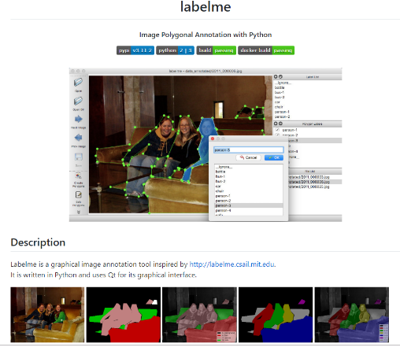
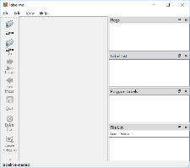
Tutorial of labeling images
Labelme: https://github.com/wkentaro/labelme
Installation of labelme in Anaconda
(use the red command to finsish the installation)
Open the GUI of labelme
Enter labelme to start up the GUI
# python3
conda create --name=labelme python=3.6
source activate labelme
# conda install -c conda-forge pyside2
# conda install pyqt
pip install pyqt5
pip install labelme
# If the Environment has already been built, execute the red lines and the labelme will be installed.
如果虛擬環境都建置好，直接下紅色的command安裝
Notes:
Labelme的使用應該具備:
Python3
Pyqt5 (建立圖形介面用的套件)
安裝指令:
pip install pyqt5
pip install labelme
Labelme (這次要使用的工具)
安裝完後 直接打入labelme便可啟動圖形化介面

Slide 13
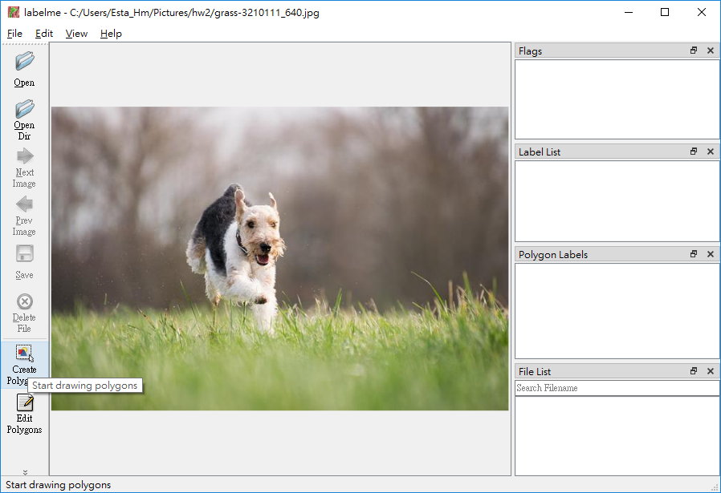
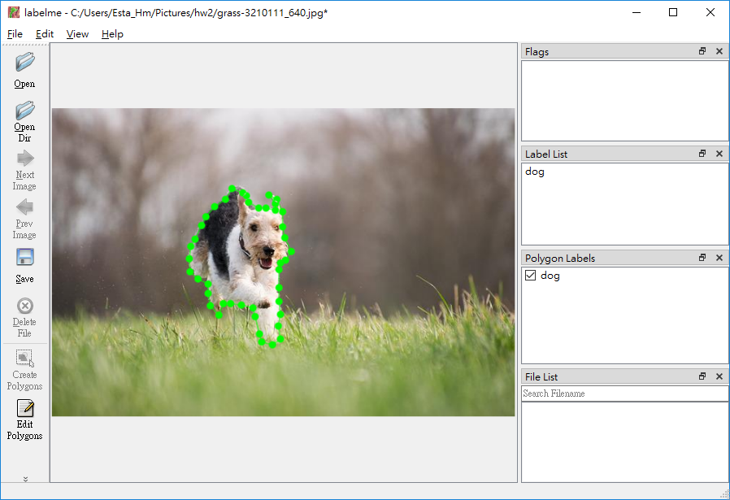
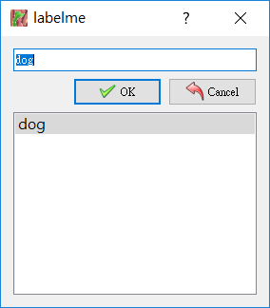
LabelMe How to mark the salient object
3. Mark the salient objects
in the image. (mouse click)
Open an image file
Create polygons
4. Dialog of naming the label object

Slide 14

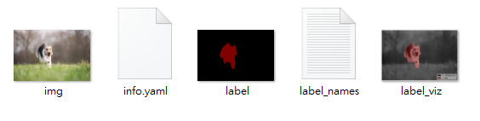

LabelMe Generate mask ground-truth
When it like this, it is the 16-bit image
4. Save the edit polygon into a json file
畫完的 polygon存檔，為json格式
{saved}.json
5. Close label me GUI. Key the following command to generate the needed files (label image)
labelme_json_to_dataset {saved}.json
Change the label image into binary mask. Save it into 8-bit grayscale, png format.
Make sure the object is marked in white.
Saved in 8-bit grayscale.
視覺顯著物體為白色(數值為255)，其他區域為黑色 (數值為0)，最後的結果要為8 bit image
Notes:
LabelMe 畫Polygon，儲存畫好的顯著物件結果 (json檔案)
用labelme的工具轉成包含label image 的dataset
把label image 轉成binary mask (8-bit png)

Slide 15
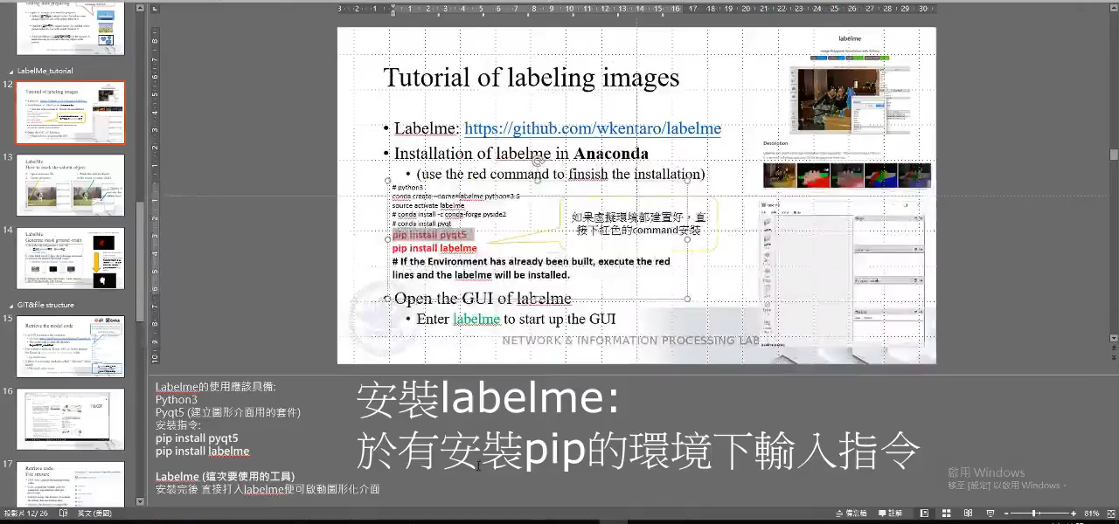
Labelme

Slide 16

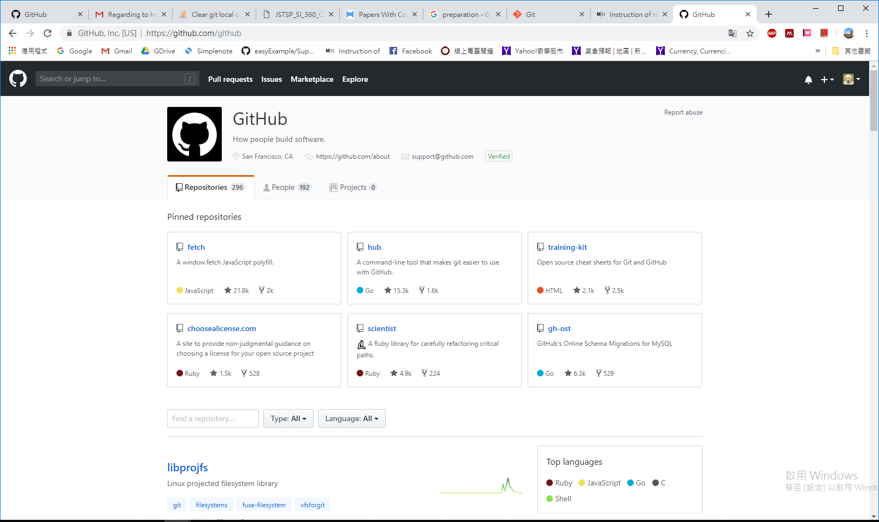

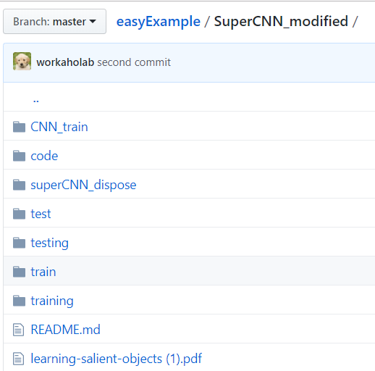
Retrieve the model code
The data obtain from GitHub should have the file structure in directory SuperCNN_modified
Use GIT to retrieve the contents:
git clone https://github.com/workaholab/easyExample.git
The model code is under the directory SuperCNN_modified
The model is built in Keras API, so firstly prepare the Keras in your virtual environment with:
pip install keras
If there is a missing package called “skimage” please install:
Pip install scikit-image
從GitHub取回來的的SuperCNN_modified
資料夾中的檔案結構

Slide 17

GIT

Slide 18
Retrieve code: File struture
CNN_train: contain the training/testing codes.
Code: contain the Matlab code for superpixel segmentation (data pre-processing)
testing/training: the directory to contain the testing data and training data.
test/train: the directory to contain the superpixel segmentation results.
Others: reference files

Slide 19
Data preprocessing: superpixel segmentation
Training 和 testing有各自的matlab code來處理superpixel segmentation的前處理。
Before feeding the input into the model, there’s a preprocessing step to turn the images and binary masks in to the superpixel unit information.
We provide a data transforming code in superCNN_modified/code
training_slic_seg_label.m: generate the superpixel segmentation information of the training data
testing_slic_seg_label.m: generate the superpixel segmentation information of the testing data
The following process we use training data as example.
後續說明以training data為例，testing data走相同的流程完成前處理

Slide 20
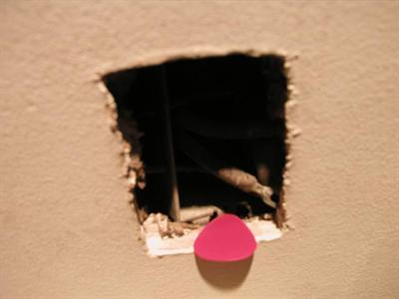

Step of data preprocessing (training)
1. Place the training dataset (images and the corresponding binary mask images) in the superCNN_modified/training directory.
The images and the corresponding binary mask should has the same name but in different format.
在前處理訓練資料時，要注意image和
Labeling 資料的名稱要相同。
2. Execute the training_slic_seg_label.m in Matlab. (The version of Matlab should contain the superpixels function)
e.g. for training data
Input1.jpg
Input1.png

Slide 21

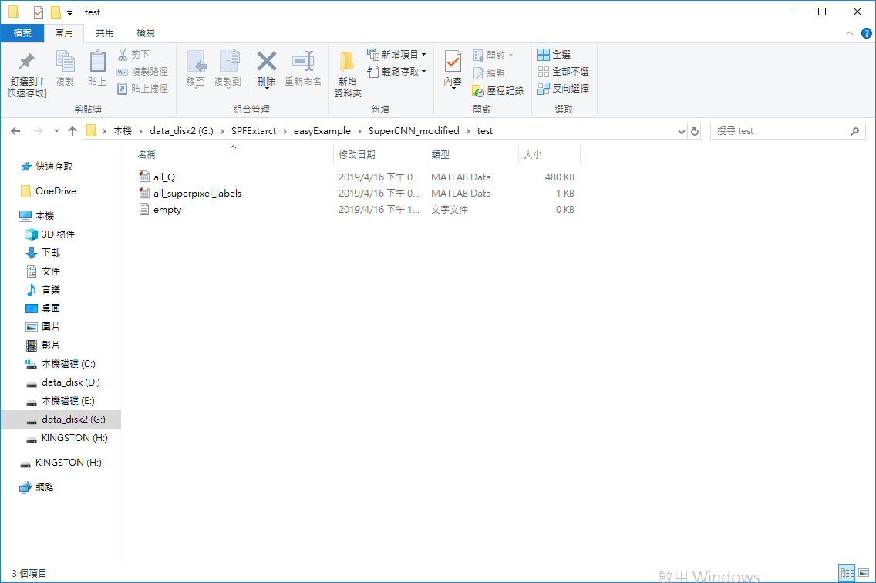
Step of data preprocessing (training)
3. It will generate two files in superCNN_modified/train:
(for training data)
all_Q.mat: containing the color features of image in superpixel units.
all_superpixel_label.mat: contain the ground truth labeling in superpixel units.
The testing data using the similar steps as above to finish the preprocessing step.
Since we need the separate result of multiple image pairs, it will be more recommended that generate the data-preprocessing information and test them separately. (one pairs at a time then testing)
同學在前面產生了6組color image和groundtruth答案，建議6組分開做testing image的前處理(一組產生一次檔案，然後testing)
Notes:
2. 執行檔案，產生兩個.mat檔案
(1) all_Q.mat: 將影像以切割成諸多superpixel後，以superpixel為單位儲存色彩特徵，並儲存起來
(2) all_superpixel_label.mat: 將影像的groundtruth 以影像superpixel切割單位(1)的切割結果，來歸納那些superpixel於binary mask中為salient object的區塊並儲存
產生的檔案要做為給deep learning model讀取的input
所以要按照程式路徑放到對的位置。

Slide 22
SuperCNN: Model training and testing
In the CNN_train directory, it include the training code and the testing code.
train_superCNN.py : execute it to train the model with superpixel pre-processing files of training data
test_superCNN.py : execute it to test the trained model with superpixel pre-processing files of testing data
Make sure the input files are set correctly:
#input data directory path training
#training
train_image_mat='../train/all_Q.mat'
train_mask_mat='../train/all_superpixel_labels.mat'
#testing
test_image_mat='../test/all_Q.mat'
test_mask_mat='../test/all_superpixel_labels.mat'
Training 和 testing有各自的python code來訓練模型及檢測模型，要確認其使用輸入位置及產生正確。
Execute the code with: python {training or testing code}

Slide 23
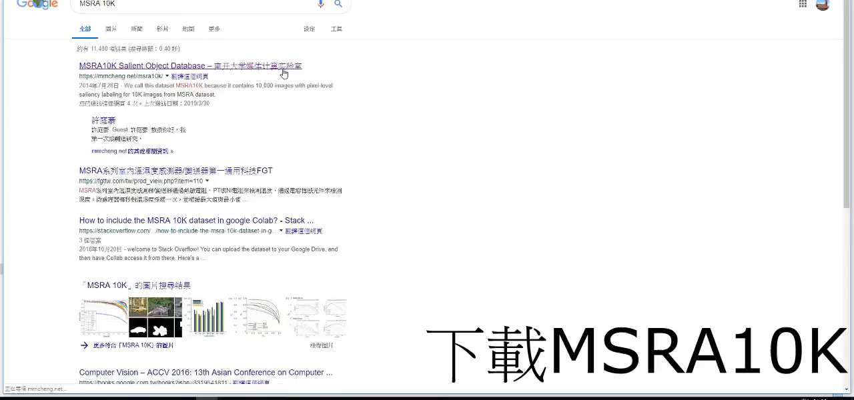
Training

Slide 24

Testing

Slide 25
Reference
Deep Learning, I. Goodfellow and Y. Bengio and A. Courville, The MIT Press, 2016.
7 Types of Neural Network Activation Functions: How to Choose?
https://missinglink.ai/guides/neural-network-concepts/7-types-neural-network-activation-functions-right/
Create your own COCO-style datasets: https://patrickwasp.com/create-your-own-coco-style-dataset/
What are the best image annotation tools available out there? https://www.quora.com/What-are-the-best-image-annotation-tools-available-out-there
Code https://github.com/yash0307/SuperCNN
Notes:
Reference:
https://paperswithcode.com/task/salient-object-detection

Slide 26
Datasets
MS COCO: http://cocodataset.org/#home
ImageNet: http://www.image-net.org/
MSRA10K Salient Object Database: https://mmcheng.net/msra10k/
ECSSD dataset: http://www.cse.cuhk.edu.hk/~leojia/projects/hsaliency/dataset.html

